Slide 1
Greedy Algorithms

Slide 2
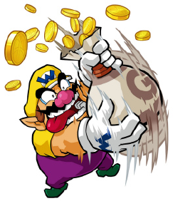
Greedy
A greedy algorithm always makes the choice that looks best at the moment
The algorithm is usually an iterative algorithm
The solution usually composed of elements. For example, a path which composed of edges, a set which composed of elements, etc.
In each iteration or step, the algorithm adds one component/element to the solution set. After final step, the solution set will be complete solution of the problem.

Slide 3
Greedy Algorithm: Principles
A greedy algorithm works in phases. At each phase:
The algorithm chooses the best you can get right now, without regard for future consequences
The algorithm hopes that by choosing a local optimum at each step, it will end up at a global optimum
For some problems, the global optimum can be achieved

Slide 4
Do all problems have greedy algorithm?
The answer is ‘NO’. Only a few problems have greedy algorithms. For example, LCS problem, Fibonacci problem, bellman ford algorithm, mergesort, Quicksort, etc. are not greedy algorithms!
Usually, a greedy algorithm happens to be faster than other algorithms. However, there are many exceptions. It may happen that greedy algorithm is slower than other algorithms (e.g., dynamic algorithm) of the same problem.
Consider the following algorithm for sorting numbers:
compute the minimum of [1. . ] and store it in [1] compute the minimum of [2. . ] and store it in [2] and so on
the above sorting algorithm is greedy, it has a running-time of $O(n^{2})$

Slide 5
Do all problems have greedy algorithm?
The answer is ‘NO’. Only a few problems have greedy algorithms. For example, LCS problem, Fibonacci problem, bellman ford algorithm, mergesort, Quicksort, etc. are not greedy algorithms!
Usually, a greedy algorithm happens to be faster than other algorithms. However, there are many exceptions. It may happen that greedy algorithm is slower than other algorithms (e.g., dynamic algorithm) of the same problem.
Consider the following algorithm for sorting numbers:
BTW is this algorithm for sorting really greedy?
compute the minimum of [1. . ] and store it in [1] compute the minimum of [2. . ] and store it in [2] and so on
the above sorting algorithm is greedy, it has a running-time of $O(n^{2})$

Slide 6
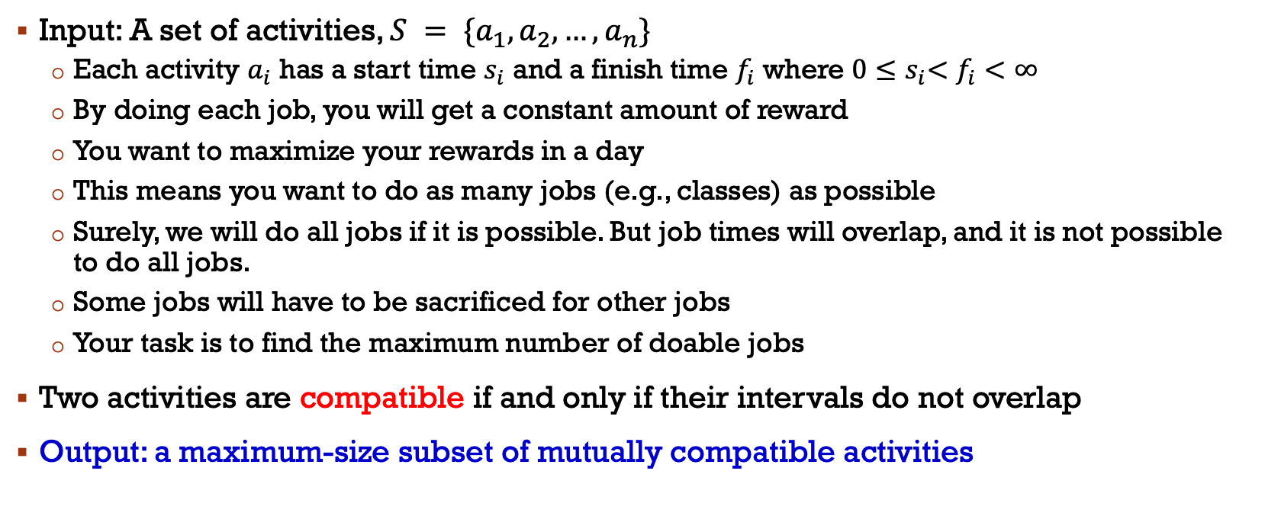
Activity Scheduling Problem
Input: A set of activities, $S = \{a_{1},a_{2},…,a_{n}\}$
Each activity $a_{i}$ has a start time $s_{i}$ and a finish time $f_{i}$ where $0{≤s}_{i}<f_{i}<∞$
By doing each job, you will get a constant amount of reward
You want to maximize your rewards in a day
This means you want to do as many jobs (e.g., classes) as possible
Surely, we will do all jobs if it is possible. But job times will overlap, and it is not possible to do all jobs.
Some jobs will have to be sacrificed for other jobs
Your task is to find the maximum number of doable jobs
Two activities are compatible if and only if their intervals do not overlap
Output: a maximum-size subset of mutually compatible activities

Slide 7
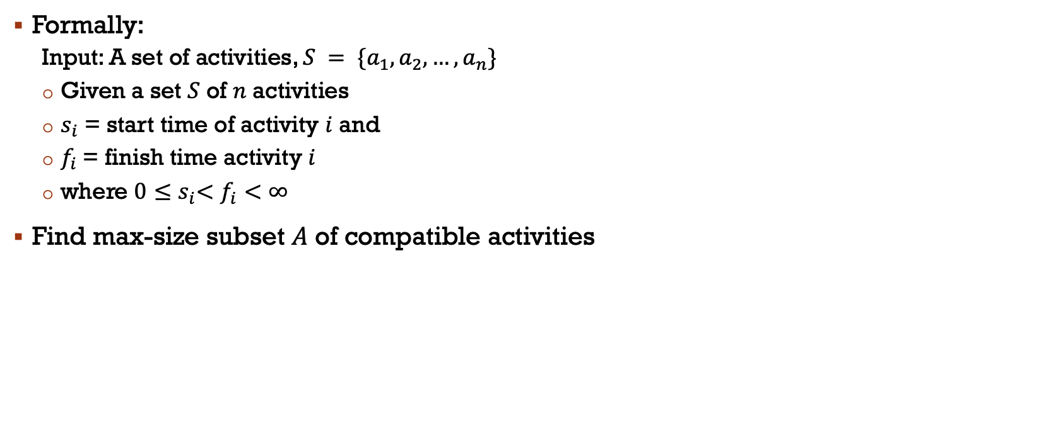
Activity Scheduling Problem
Formally:
Input: A set of activities, $S = \{a_{1},a_{2},…,a_{n}\}$
Given a set $S$ of $n$ activities
$s_{i}$ = start time of activity $i$ and
$f_{i}$= finish time activity $i$
where $0{≤s}_{i}<f_{i}<∞$
Find max-size subset $A$ of compatible activities

Slide 8
Activity Scheduling Problem
Formally:
Input: A set of activities, $S = \{a_{1},a_{2},…,a_{n}\}$
Given a set $S$ of $n$ activities
$s_{i}$ = start time of activity $i$ and
$f_{i}$= finish time activity $i$
where $0{≤s}_{i}<f_{i}<∞$
Find max-size subset $A$ of compatible activities

Slide 9
Activity Scheduling Problem
i 1 2 3 4 5 6 7 8 9 10 11
s_{i} 1 3 0 5 3 5 6 8 8 2 12
f_{i} 4 5 6 7 8 9 10 11 12 13 14
What is the maximum number of activities that can be completed?

Slide 10
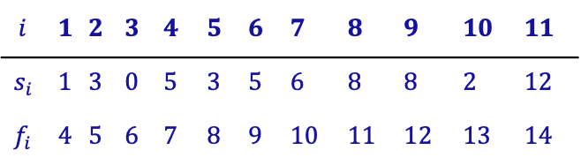

Activity Scheduling Problem
11 10 9 8 7 6 5 4 3 2 1
$$i$$ | 1 | 2 | 3 | 4 | 5 | 6 | 7 | 8 | 9 | 10 | 11
$$s_{i}$$ | 1 | 3 | 0 | 5 | 3 | 5 | 6 | 8 | 8 | 2 | 12
$$f_{i}$$ | 4 | 5 | 6 | 7 | 8 | 9 | 10 | 11 | 12 | 13 | 14

Slide 11

Activity Scheduling Problem
11 10 9 8 7 6 5 4 3 2 1
$$i$$ | 1 | 2 | 3 | 4 | 5 | 6 | 7 | 8 | 9 | 10 | 11
$$s_{i}$$ | 1 | 3 | 0 | 5 | 3 | 5 | 6 | 8 | 8 | 2 | 12
$$f_{i}$$ | 4 | 5 | 6 | 7 | 8 | 9 | 10 | 11 | 12 | 13 | 14
$\left\{a_{3},a_{9},a_{11}\right\}$ can be scheduled

Slide 12
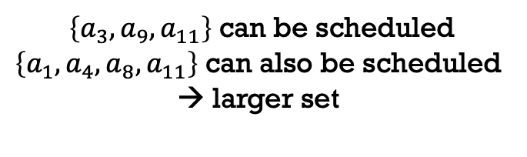
Activity Scheduling Problem
11 10 9 8 7 6 5 4 3 2 1
$$i$$ | 1 | 2 | 3 | 4 | 5 | 6 | 7 | 8 | 9 | 10 | 11
$$s_{i}$$ | 1 | 3 | 0 | 5 | 3 | 5 | 6 | 8 | 8 | 2 | 12
$$f_{i}$$ | 4 | 5 | 6 | 7 | 8 | 9 | 10 | 11 | 12 | 13 | 14
$\left\{a_{3},a_{9},a_{11}\right\}$ can be scheduled
$\left\{a_{1},a_{4},a_{8}, a_{11}\right\}$ can also be scheduled
→ larger set

Slide 13
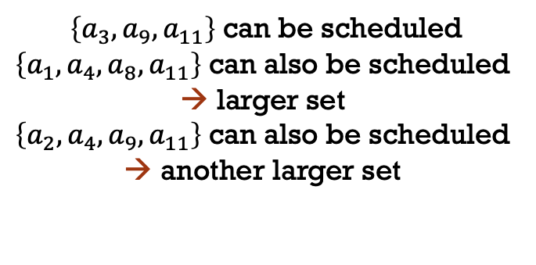
Activity Scheduling Problem
11 10 9 8 7 6 5 4 3 2 1
$$i$$ | 1 | 2 | 3 | 4 | 5 | 6 | 7 | 8 | 9 | 10 | 11
$$s_{i}$$ | 1 | 3 | 0 | 5 | 3 | 5 | 6 | 8 | 8 | 2 | 12
$$f_{i}$$ | 4 | 5 | 6 | 7 | 8 | 9 | 10 | 11 | 12 | 13 | 14
$\left\{a_{3},a_{9},a_{11}\right\}$ can be scheduled
$\left\{a_{1},a_{4},a_{8}, a_{11}\right\}$ can also be scheduled
larger set
$\left\{a_{2},a_{4},a_{9}, a_{11}\right\}$ can also be scheduled
another larger set

Slide 14
Activity Scheduling Problem
The greedy choice can be applied to find solutions (the maximum number of activities that can be performed) by using
earliest finish time
earliest start time
shortest interval

Slide 15
Activity Scheduling Problem
The greedy choice can be applied to find solutions (the maximum number of activities that can be performed) by using
earliest finish time
earliest start time
shortest interval
Always gives optimal solution

Slide 16
Activity Scheduling Problem
The greedy choice can be applied to find solutions (the maximum number of activities that can be performed) by using
earliest finish time
earliest start time
shortest interval
Always gives optimal solution
Does not always give optimal solution
Does not always give optimal solution

Slide 17
Activity Scheduling: Early Finish Time
Select the activity with the earliest finish time from the consideration list
Eliminate the activity from consideration list
Eliminate all non-compatible activities from the consideration list
Repeat unless the consideration list is empty

Slide 18
Activity Scheduling Problem
11 10 9 8 7 6 5 4 3 2 1
$$i$$ | 1 | 2 | 3 | 4 | 5 | 6 | 7 | 8 | 9 | 10 | 11
$$s_{i}$$ | 1 | 3 | 0 | 5 | 3 | 5 | 6 | 8 | 8 | 2 | 12
$$f_{i}$$ | 4 | 5 | 6 | 7 | 8 | 9 | 10 | 11 | 12 | 13 | 14

Slide 19

Activity Scheduling Problem
11 10 9 8 7 6 5 4 3 2 1
$$i$$ | 1 | 2 | 3 | 4 | 5 | 6 | 7 | 8 | 9 | 10 | 11
$$s_{i}$$ | 1 | 3 | 0 | 5 | 3 | 5 | 6 | 8 | 8 | 2 | 12
$$f_{i}$$ | 4 | 5 | 6 | 7 | 8 | 9 | 10 | 11 | 12 | 13 | 14
$$A=\{a_{1}\}$$

Slide 20
Activity Scheduling Problem
11 10 9 8 7 6 5 4 3 2 1
$$i$$ | 1 | 2 | 3 | 4 | 5 | 6 | 7 | 8 | 9 | 10 | 11
$$s_{i}$$ | 1 | 3 | 0 | 5 | 3 | 5 | 6 | 8 | 8 | 2 | 12
$$f_{i}$$ | 4 | 5 | 6 | 7 | 8 | 9 | 10 | 11 | 12 | 13 | 14
$$A=\{a_{1}\}$$

Slide 21

Activity Scheduling Problem
11 10 9 8 7 6 5 4 3 2 1
$$i$$ | 1 | 2 | 3 | 4 | 5 | 6 | 7 | 8 | 9 | 10 | 11
$$s_{i}$$ | 1 | 3 | 0 | 5 | 3 | 5 | 6 | 8 | 8 | 2 | 12
$$f_{i}$$ | 4 | 5 | 6 | 7 | 8 | 9 | 10 | 11 | 12 | 13 | 14
$$A=\{a_{1}, a_{4}\}$$

Slide 22
Activity Scheduling Problem
11 10 9 8 7 6 5 4 3 2 1
$$i$$ | 1 | 2 | 3 | 4 | 5 | 6 | 7 | 8 | 9 | 10 | 11
$$s_{i}$$ | 1 | 3 | 0 | 5 | 3 | 5 | 6 | 8 | 8 | 2 | 12
$$f_{i}$$ | 4 | 5 | 6 | 7 | 8 | 9 | 10 | 11 | 12 | 13 | 14
$$A=\{a_{1}, a_{4}\}$$

Slide 23

Activity Scheduling Problem
11 10 9 8 7 6 5 4 3 2 1
$$i$$ | 1 | 2 | 3 | 4 | 5 | 6 | 7 | 8 | 9 | 10 | 11
$$s_{i}$$ | 1 | 3 | 0 | 5 | 3 | 5 | 6 | 8 | 8 | 2 | 12
$$f_{i}$$ | 4 | 5 | 6 | 7 | 8 | 9 | 10 | 11 | 12 | 13 | 14
$$A=\{a_{1}, a_{4},a_{8}\}$$

Slide 24
Activity Scheduling Problem
11 10 9 8 7 6 5 4 3 2 1
$$i$$ | 1 | 2 | 3 | 4 | 5 | 6 | 7 | 8 | 9 | 10 | 11
$$s_{i}$$ | 1 | 3 | 0 | 5 | 3 | 5 | 6 | 8 | 8 | 2 | 12
$$f_{i}$$ | 4 | 5 | 6 | 7 | 8 | 9 | 10 | 11 | 12 | 13 | 14
$$A=\{a_{1}, a_{4},a_{8}\}$$

Slide 25

Activity Scheduling Problem
11 10 9 8 7 6 5 4 3 2 1
$$i$$ | 1 | 2 | 3 | 4 | 5 | 6 | 7 | 8 | 9 | 10 | 11
$$s_{i}$$ | 1 | 3 | 0 | 5 | 3 | 5 | 6 | 8 | 8 | 2 | 12
$$f_{i}$$ | 4 | 5 | 6 | 7 | 8 | 9 | 10 | 11 | 12 | 13 | 14
$$A=\{a_{1}, a_{4},a_{8},a_{11}\}$$

Slide 26
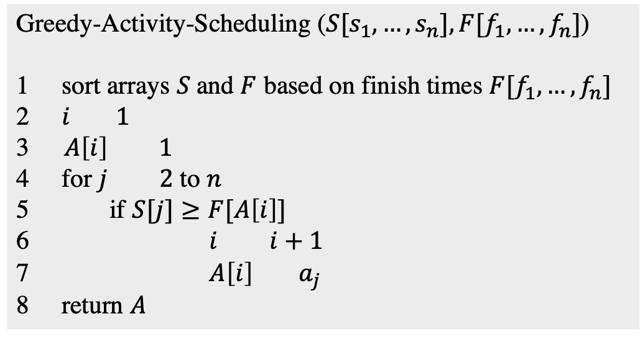
Activity Scheduling: Early Finish Time
Greedy-Activity-Scheduling ($S[s_{1},…,s_{n}], F[f_{1},…,f_{n}]$)
1 sort arrays $S$and $F$ based on finish times $F[f_{1},…,f_{n}]$
2 $i 1$
3 $A\left[i\right] 1$
4 for $j 2$ to $n$
5 if $S[j]≥F[A\left[i\right]]$
6 $i i+1$
7 $A\left[i\right] { a}_{j}$
8 return $A$

Slide 27
Activity Scheduling: Early Finish Time
Greedy-Activity-Scheduling ($S[s_{1},…,s_{n}], F[f_{1},…,f_{n}]$)
1 sort arrays $S$and $F$ based on finish times $F[f_{1},…,f_{n}]$
2 $i 1$
3 $A\left[i\right] 1$
4 for $j 2$ to $n$
5 if $S[j]≥F[A\left[i\right]]$
6 $i i+1$
7 $A\left[i\right] { a}_{j}$
8 return $A$
Running time is $O(nlogn)$ → from sorting operation

Slide 28
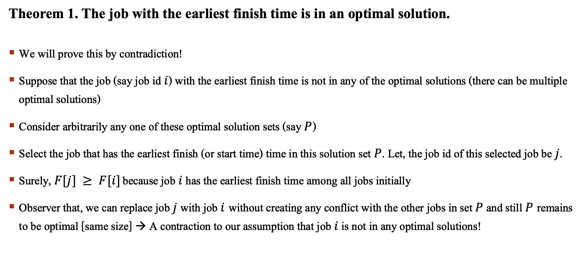
Activity Scheduling: Early Finish Time
Theorem 1. The job with the earliest finish time is in an optimal solution.
We will prove this by contradiction!
Suppose that the job (say job id $i$) with the earliest finish time is not in any of the optimal solutions (there can be multiple optimal solutions)
Consider arbitrarily any one of these optimal solution sets (say $P$)
Select the job that has the earliest finish (or start time) time in this solution set $P$. Let, the job id of this selected job be $j$.
Surely, $F[j] ≥ F[i]$ because job $i$ has the earliest finish time among all jobs initially
Observer that, we can replace job $j$ with job $i$without creating any conflict with the other jobs in set $P$ and still $P$remains to be optimal [same size] → A contraction to our assumption that job $i$ is not in any optimal solutions!

Slide 29
Activity Scheduling: Early Finish Time
Prove that Greedy-Activity-Scheduling generate an optimal solution.
According theorem 1, we select the first job since it is in optimal solution.
Then, we remove all conflicting jobs from the job set.
The original problem is then transformed to a similar problem of smaller size.
So, we continue selecting jobs following theorem 1 and we always remain optimal.

Slide 30
Activity Scheduling: Early Start Time
Select the activity with the earliest start
Eliminate the activities that could not be scheduled
Repeat!
11 10 9 8 7 6 5 4 3 2 1

Slide 31

Activity Scheduling: Early Start Time
Select the activity with the earliest start
Eliminate the activities that could not be scheduled
Repeat!
$$A = \{a3\}$$
11 10 9 8 7 6 5 4 3 2 1

Slide 32
Activity Scheduling: Early Start Time
Select the activity with the earliest start
Eliminate the activities that could not be scheduled
Repeat!
$$A = \{a3\}$$
11 10 9 8 7 6 5 4 3 2 1

Slide 33

Activity Scheduling: Early Start Time
Select the activity with the earliest start
Eliminate the activities that could not be scheduled
Repeat!
$$A =\{a_{3},a_{7}\}$$
11 10 9 8 7 6 5 4 3 2 1

Slide 34
Activity Scheduling: Early Start Time
Select the activity with the earliest start
Eliminate the activities that could not be scheduled
Repeat!
$$A =\{a_{3},a_{7}\}$$
11 10 9 8 7 6 5 4 3 2 1

Slide 35

Activity Scheduling: Early Start Time
Select the activity with the earliest start
Eliminate the activities that could not be scheduled
Repeat!
$$A =\{a_{3},a_{7},a_{11}\}$$
11 10 9 8 7 6 5 4 3 2 1

Slide 36
Activity Scheduling: Early Start Time
Select the activity with the earliest start
Eliminate the activities that could not be scheduled
Repeat!
$$A =\{a_{3},a_{7},a_{11}\}$$
11 10 9 8 7 6 5 4 3 2 1
Not an optimal solution

Slide 37
Activity Scheduling: Shortest interval
Select the activity with the shortest interval
Eliminate the activities that could not be scheduled
Repeat!
11 10 9 8 7 6 5 4 3 2 1

Slide 38

Activity Scheduling: Early Start Time
Select the activity with the earliest start
Eliminate the activities that could not be scheduled
Repeat!
$$A = \{a_{2}\}$$
11 10 9 8 7 6 5 4 3 2 1

Slide 39
Activity Scheduling: Early Start Time
Select the activity with the earliest start
Eliminate the activities that could not be scheduled
Repeat!
$$A = \{a3\}$$
11 10 9 8 7 6 5 4 3 2 1

Slide 40

Activity Scheduling: Early Start Time
Select the activity with the earliest start
Eliminate the activities that could not be scheduled
Repeat!
$$A =\{a_{3},a_{11}\}$$
11 10 9 8 7 6 5 4 3 2 1

Slide 41

Activity Scheduling: Early Start Time
Select the activity with the earliest start
Eliminate the activities that could not be scheduled
Repeat!
$$A =\{a_{3},a_{11},a_{4}\}$$
11 10 9 8 7 6 5 4 3 2 1

Slide 42
Activity Scheduling: Early Start Time
Select the activity with the earliest start
Eliminate the activities that could not be scheduled
Repeat!
$$A =\{a_{3},a_{11},a_{4}\}$$
11 10 9 8 7 6 5 4 3 2 1

Slide 43

Activity Scheduling: Early Start Time
Select the activity with the earliest start
Eliminate the activities that could not be scheduled
Repeat!
$$A =\{a_{3},a_{11},a_{4},a_{8}\}$$
11 10 9 8 7 6 5 4 3 2 1

Slide 44
Activity Scheduling: Early Start Time
Select the activity with the earliest start
Eliminate the activities that could not be scheduled
Repeat!
$$A =\{a_{3},a_{11},a_{4},a_{8}\}$$
11 10 9 8 7 6 5 4 3 2 1
Gives optimal solution in this example

Slide 45

Activity Scheduling: Early Start Time
Select the activity with the earliest start
Eliminate the activities that could not be scheduled
Repeat!
$$A =\{\}$$
6 5 4 3 2 1

Slide 46

Activity Scheduling: Early Start Time
Select the activity with the earliest start
Eliminate the activities that could not be scheduled
Repeat!
$$A =\{a_{2}\}$$
6 5 4 3 2 1

Slide 47

Activity Scheduling: Early Start Time
Select the activity with the earliest start
Eliminate the activities that could not be scheduled
Repeat!
$$A =\{a_{2},a_{4}\}$$
6 5 4 3 2 1

Slide 48
Activity Scheduling: Early Start Time
Select the activity with the earliest start
Eliminate the activities that could not be scheduled
Repeat!
$$A =\{a_{2},a_{4}\}$$
6 5 4 3 2 1
Not an optimal solution

Slide 49
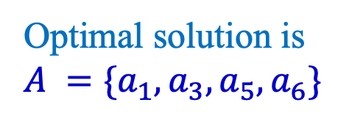
Activity Scheduling: Early Start Time
Select the activity with the earliest start
Eliminate the activities that could not be scheduled
Repeat!
$$A =\{a_{2},a_{4}\}$$
6 5 4 3 2 1
Not an optimal solution
Optimal solution is
$$A =\{a_{1},a_{3},a_{5},a_{6}\}$$

Slide 50
Content Courtesy
Dr. Abul Kashem Mia, Professor, CSE, BUET
Sukarna Barua, Assistant Professor, CSE, BUET

